Slide 1
MIDDLETON CHENEY
FOOTBALL CLUB

Slide 2
RESERVES TEAM
1983-84
SEASON
LORD JERSEYLEAGUE
DIVISION lI
AND CUPS

Slide 3
MIDDLETON CHENEY
1st Team Manager Dick Ashburn & Alan Coleman
Res Team Manager Pete Allington
A. Team Manager Jeff Sargent & Ian Wickens
1st Team Banbury Premier League
Res Team Lord Jersey League Division II
A Team Lord Jersey League Division III

Slide 4
September 7th 1983 Lord Jersey League Div II - Home
Middleton Res 3 v 3 Chesterton
G. Barrett
K. Pye
D. Laud
I. Braggins
M. Evans Goal scorers A. White 2
A. Wheatley A. Wheatley
R. Northover
M. Cato
A. White
J. Boyles
N. Franklin
Sub- N. Berry
Sub-

Slide 5
September 10th 1983 Lord Jersey League Div II - Away
Bardwell 0 v 3 Middleton Res
A. Coleman
P. Allington
D. Laud
I. Braggins
M. Ashburn Goal scorers M. Cato 2
M. Cato N. Berry
P. Ashburn
N. Franklin
J. Boyles
N. Berry
A. Ashton
Sub-
Sub-

Slide 6
September 17th 1983 Lord Jersey League Div II - Home
Middleton Res 6 v 3 Wootten
M. Twynham
D. Allington
M. Cannon
I. Braggins
P. Allington Goal scorers N. Berry 2
R. Northover D. Laud 2
M. Cato B. Needham
N. Franklin M. Cato
B. Needham
D. Laud
N. Berry
Sub-
Sub-

Slide 7
September 24th 1983 Lord Jersey League Div II - Away
Launton Sports 3 v 0 Middleton Res
M. Twynham
D. Allington
M. Cannon
I. Braggins
M. Evans Goal scorers
R. Northover
M. Cato
N. Franklin
N. Berry
D. Laud
B. Needham
Sub-
Sub-

Slide 8
October 8th 1983 Lord Jersey League Div II - Home
Middleton Res 1 v 2 Steeple Aston
A. Coleman
D. Allington
M. Cannon
I. Braggins
R. Northover Goal scorers J. Boyles
M. Evans
M. Cato
N. Franklin
N. Berry
J. Boyles
D. Laud
Sub- N. Davidson
Sub-

Slide 9
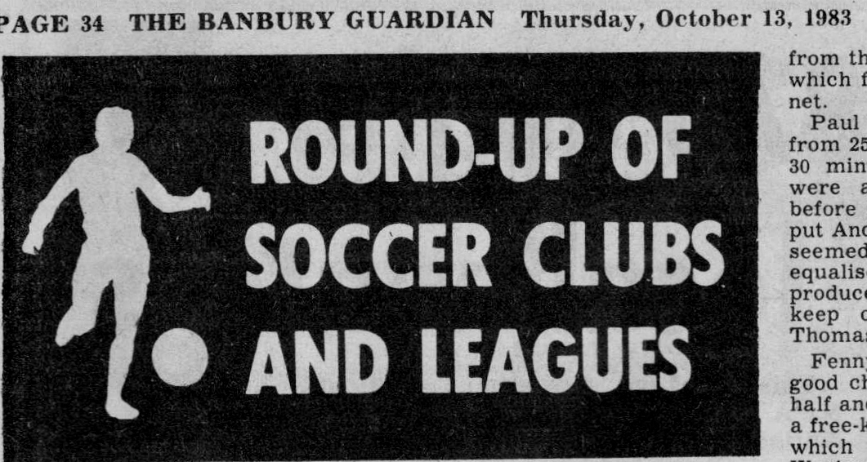
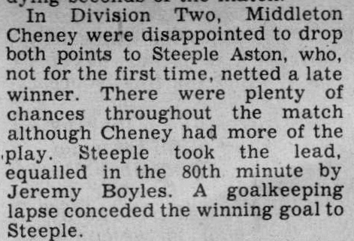

Slide 10
October 15th 1983 Northants Area Cup 1st Rd - Away
Flore Res 1 v 4 Middleton Res
A. Coleman
D. Allington
M. Cannon
M. Ashburn
I. Braggins Goal scorers J. Boyles 2
R. Northover I. Braggins
M. Cato Own goal
N. Johnson
N. Berry
J. Boyles
D. Laud
Sub- P. Allington
Sub-

Slide 11
October 22nd 1983 Lord Jersey Cup 1st Rd - Home
Middleton Res 2 v 1 Islip
A. Coleman
D. Allington
M. Ashburn
M. Cannon
M. Evans Goal scorers A. White
D. Laud D. Laud
N. Johnson
I. Braggins
N. Berry
A. White
Dar Gascoigne
Sub- N. Davidson
Sub-

Slide 12
October 29th 1983 Lord Jersey League Div II - Home
Middleton Res 3 v 1 Fritwell
A. Coleman
D. Allington
P. Allington
M. Ashburn
M. Lee Goal scorers A. White
P. Holland D. Laud
R. Northover N. Berry
D. Laud
S. Harris
A. White
N. Berry
Sub- I. Crofts
Sub-

Slide 13
November 5th 1983 Lord Jersey League Div II - Away
Merton 2 v 5 Middleton Res
A. Coleman
D. Allington
M. Ashburn
I. Braggins
D. Laud Goal scorers A. White 3
N. Johnson J. Boyles
Paul Gwynne N. Davidson
A. White
J. Boyles
N. Berry
P. Holland
Sub- N. Davidson
Sub- M. Cato

Slide 14
November 12th 1983 Northants Area Cup 2nd Rd - Away
Spratton 0 v 3 Middleton Res
A. Coleman
D. Allington
M. Cannon
M. Ashburn
D. Laud Goal scorers A. White 3
M. Cato
N. Johnson
P. Holland
N. Berry
A. White
J. Boyles
Sub- P. Allington
Sub-

Slide 15
November 19th 1983 Eric Morris Cup 1st Rd - Home
Middleton Res 1 v 1 Merton
A. Coleman
D. Allington
M. Ashburn
M. Cannon
M. Cato Goal scorers A. White
I. Braggins
N. Johnson
P. Holland
D. Laud
J. Boyles
A. White
Sub- M. Lee
Sub-

Slide 16
November 26th 1983 Eric Morris Cup 1st Rd Replay - Away
Merton 1 v 0 Middleton Res
A. Coleman
D. Allington
M. Ashburn
M. Lee
P. Holland Goal scorers
N. Johnson
D. Laud
N. Berry
J. Boyles
R. Northover
Dar Gascoigne
Sub- P. Allington
Sub-

Slide 17
December 3rd 1983 Lord Jersey League Div II - Away
Ambrosden 1 v 5 Middleton Res
A. Coleman
M. Lee
M. Cannon
M. Cato
P. Ashburn Goal scorers N. Berry 3
R. Northover N. Johnson
N. Johnson D. Laud
P. Holland
D. Laud
A. White
N. Berry
Sub- Dar Gascoigne
Sub-

Slide 18
December 10th 1983 Lord Jersey Cup 2nd Rd - Home
Middleton Res 5 v 3 Crusaders
M. Garrett
M. Lee
D. Allington
M. Ashburn
M. Cannon Goal scorers N. Johnson
N. Johnson A. White
M. Cato J. Boyles
D. Laud D. Allington
J. Boyles Own goal
A. White
N. Berry
Sub- P. Holland
Sub-

Slide 19
December 17th 1983 Northants Area Cup 3rd Rd - Away
Northampton Glen Eagles 4 v 2 Middleton Res
M. Garrett
D. Allington
M. Ashburn
M. Cannon
M. Lee Goal scorers J. Boyles
P. Holland A. White
N. Johnson
D. Laud
J. Boyles
A. White
N. Berry
Sub- S. Harris
Sub-

Slide 20
December 31st 1983 Arthur Crawford Cup - Away
Heyford Utd 3 v 5 Middleton Res
M. Garrett
D. Allington
M. Cato
M. Ashburn
M. Lee Goal scorers J. Boyles 2
I. Braggins A. White
P. Holland D. Laud
D. Laud Own goal
N. Berry
A. White
J. Boyles
Sub- S. Harris
Sub-

Slide 21
January 7th 1984 Lord Jersey League Div II - Home
Middleton Res 1 v 4 Bardwell
M. Garrett
M. Lee
M. Ashburn
M. Cannon
M. Cato Goal scorers D. Allington
I. Braggins
N. Johnson
P. Holland
A. White
D. Laud
D. Allington
Sub- S. Harris
Sub-

Slide 22
January 14th 1984 Arthur Crawford Cup - Home
Middleton Res 3 v 1 Heyford Utd
M. Garrett
D. Allington
I. Braggins
M. Ashburn
M. Lee Goal scorers S. Harris
Dar Gascoigne A. White
P. Holland D. Allington
D. Laud
S. Harris
A. White
N. Berry
Sub- P. Allington
Sub-

Slide 23
January 28th 1984 Lord Jersey League Div II - Home
Middleton Res 6 v 2 Ambrosden
M. Garrett
M. Lee
M. Reynolds
M. Ashburn
D. Allington Goal scorers D. Laud 3
J. Boyles I. Braggins 2
D. Laud A. White
I. Braggins
S. Harris
A. White
N. Berry
Sub- M. Cato
Sub-

Slide 24
February 4th 1984 Arthur Crawford Cup - Away
Islip 3 v 1 Middleton Res
M. Garrett
D. Allington
M. Ashburn
I. Braggins
M. Cato Goal scorers J. Boyles
C. Farrow
D. Laud
N. Berry
A. White
J. Boyles
M. Bidwell
Sub- P. Allington
Sub-

Slide 25
February 11th 1984 Lord Jersey Cup 3rd Rd - Away
Fritwell 3 v 0 Middleton Res
A. Coleman
D. Allington
P. Allington
M. Ashburn
M. Lee Goal scorers
M. Cato
D. Laud
I. Braggins
N. Berry
A. White
J. Boyles
Sub- S. Harris
Sub-

Slide 26
February 18th 1984 Arthur Crawford Cup - Home
Middleton Res 3 v 0 Merton
A. Coleman
M. Bidwell
D. Allington
J. Boyles
M. Cato Goal scorers C. Farrow 2
I. Braggins A. White
R. Northover
D. Laud
A. White
C. Farrow
A. Wheatley
Sub- Pete Gwynne
Sub-

Slide 27
February 25th 1984 Arthur Crawford Cup - Away
Merton 0 v 1 Middleton Res
A. Coleman
D. Allington
M. Bidwell
J. Boyles
M. Cato Goal scorers A. White
I. Braggins
D. Laud
M. Cannon
A. White
C. Farrow
R. Northover
Sub- N. Berry
Sub-

Slide 28
March 10th 1984 Arthur Crawford Cup - Away
Launton 2 v 1 Middleton Res
A. Coleman
D. Allington
M. Ashburn
I. Walters
J. Boyles Goal scorers J. Boyles
M. Cato
D. Laud
I. Braggins
R. Northover
A. White
N. Berry
Sub-
Sub-

Slide 29
March 17th 1984 Lord Jersey League Div II - Home
Middleton Res 3 v 2 Isilp
A. Coleman
D. Allington
I. Walters
J. Boyles
M. Cato Goal scorers J. Boyles 2
D. Laud N. Berry
R. Northover
I. Braggins
N. Berry
M. Howes
C. Farrow
Sub- P. Holland
Sub-

Slide 30
March 24th 1984 Arthur Crawford Cup - Home
Middleton Res 3 v 4 Islip
A. Coleman
D. Allington
R. Northover
J. Boyles
M. Ashburn Goal scorers J. Boyles
I. Braggins M. Cannon
D. Laud R. Northover
I. Walters
N. Berry
C. Farrow
M. Cannon
Sub-
Sub-

Slide 31
March 31st 1984 Lord Jersey League Div II - Home
Middleton Res 2 v 0 Islip
A. Coleman
D. Allington
J. Boyles
M. Cato
M. Ashburn Goal scorers A. White
I. Braggins C. Farrow
A. White
R. Northover
M. Howes
C. Farrow
M. Cannon
Sub- S. Wilkes
Sub-

Slide 32
April 3rd 1984 Arthur Crawford Cup - Home
Middleton 1 v 0 Launton
A. Coleman
D. Allington
J. Boyles
M. Cato
I. Walters Goal scorers Paul Gwynne
R. Northover
D. Laud
I. Braggins Booked
M. Ashburn
A. White
M. Cannon
Sub- Paul Gwynne
Sub-

Slide 33
April 7th 1984 Lord Jersey League Div II - Home
Middleton Res 5 v 0 Heyford Utd
A. Coleman
D. Allington
M. Ashburn
M. Cato
R. Northover Goal scorers D. Laud
D. Laud I. Braggins
I. Braggins Paul Gwynne
M. Cannon C. Farrow
Paul Gwynne A. White
C. Farrow Booked
A. White
Sub- Pete Gwynne
Sub-

Slide 34
April 10th 1984 Arthur Crawford Cup - Home
Middleton 7 v 2 Bardwell
M. Garrett
D. Allington
M. Ashburn
J. Boyles
R. Northover Goal scorers A. Wheatley 2
D. Laud I. Braggins
N. Berry A. White
A. White C. Farrow
C. Farrow D. Laud
A. Wheatley D. Allington
N. Davidson
Sub- I. Braggins
Sub-

Slide 35
April 14th 1984 Arthur Crawford Cup - Away
Bardwell 0 v 4 Middleton
A. Coleman
D. Allington
R. Northover
M. Cannon
M. Ashburn Goal scorers D. Laud
I. Walters A. Wheatley
D. Laud C. Farrow
A. Wheatley N. Berry
A. White
C. Farrow
N. Berry
Sub- S. King
Sub-

Slide 36
April 21st 1984 Lord Jersey League Div II - Home
Middleton Res 2 v 1 Launton
A. Coleman
M. Ashburn
J. Boyles
I. Braggins
R. Northover Goal scorers N. Berry
D. Laud A. White
I. Walters
A. Wheatley
N. Berry
C. Farrow
A. White
Sub- Paul Gwynne
Sub-

Slide 37
May 1st 1984 Lord Jersey League Div II - Away
Merton 1 v 1 Middleton Res
A. Coleman
R. Northover
M. Cannon
J. Boyles
M. Ashburn Goal scorers A. Wheatley
I. Braggins
I. Walters
D. Laud
N. Berry
C. Farrow
A. Wheatley
Sub- D. Allington
Sub-

Slide 38
May 2nd 1984 Lord Jersey League Div II - Away
Fritwell 3 v 3 Middleton Res
A. Coleman
D. Allington
J. Boyles
M. Ashburn
R. Northover Goal scorers C. Farrow 2
M. Cannon I. Braggins
I. Braggins
I. Walters
N. Berry
C. Farrow
P. Wilkins
Sub- P. Allington
Sub-

Slide 39
May 5th 1984 Lord Jersey League Div II - Away
Chesterton 2 v 1 Middleton Res
A. Coleman
D. Allington
J. Boyles
M. Ashburn
R. Northover Goal scorers Own goal
M. Cannon
I. Braggins
I. Walters
C. Reynolds
C. Farrow
M. Callow
Sub- K. Buckland
Sub-

Slide 40
May 8th 1984 Lord Jersey League Div II - Away
Steeple Aston 2 v 3 Middleton Res
A. Coleman
D. Allington
J. Boyles
M. Ashburn
R. Northover Goal scorers M. Ashburn
M. Cannon A. White
I. Braggins J. Boyles
I. Walters
A. White
C. Farrow
Pete Gwynne
Sub- N. Davidson
Sub-

Slide 41
May 12th 1984 Lord Jersey League Div II - Away
Heyford Utd 2 v 2 Middleton Res
M. Garrett
M. Ashburn
J. Boyles
Pete Gwynne
R. Northover Goal scorers B. Needham
A. Ashton J. Boyles
M. Cannon
I. Walters
C. Farrow
B. Needham
A. White
Sub-
Sub-

Slide 42
May 18th 1984 Lord Jersey League Div II - Away
Wooton 1 v 5 Middleton Res
A. Coleman
D. Allington
M. Ashburn
J. Boyles
R. Northover Goal scorers A. White 2
M. Cannon F. Hancock
I. Braggins I. Braggins
I. Walters No name x 1
N. Davidson
A. White
F. Hancock
Sub- Pete Gwynne
Sub-

